Slide 1
Development of LLVM Backend for MRISC32 ISA using GlobalISel
Name: Shobhit Sinha
Roll no: 2200291530105
Mentor: Dr. Pratibha Singh
KIET Group of Institutions,
Computer Science and Engineering(AI&ML)

Slide 2
What is MRISC32?
MRISC32 is a 32-bit RISC style instruction set architecture, designed to be efficient, powerful, forward looking and easy to work with[1].
Modern features introduced in MRISC32
The three fundamental building blocks of any contemporary ISA, i.e. integer, floating-point and vector, are all first class citizens and work together rather than in separate silos.
Floating-point and Integer values share the same register file.
Vector register size is defined by the implementation instead of ISA.
This makes it suitable to use MRISC32 for a variety of applications from embedded and IOT(small or negligible vector register width) to AI/ML heavy workloads used in High Performance Computing(larger vector size).

Slide 3
What is LLVM?
LLVM[3] is a compiler development framework which includes several modular units.
Why is LLVM used?
Building a compiler consists of several stages - Lexing, Parsing, Semantic Analysis (Frontend) Optimisations(Middle-end), Code generation(Backend)
Without infrastructure like LLVM, compiler developers have to construct all the phases themselves.
But efficient and optimised code-generation requires deep knowledge of the processor architecture.
Therefore, it becomes difficult for development teams developing a particular language(eg. C++) or library(eg. Pytorch) to provide support for a vast range of architecture(x86, RISC-V, PowerPC, etc)

Slide 4
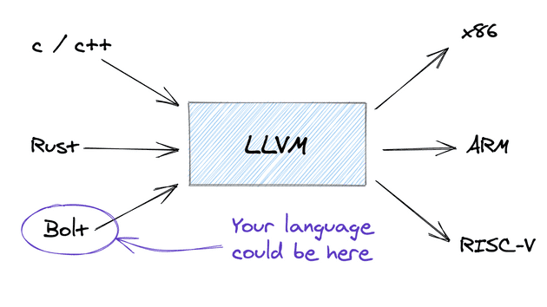
LLVM allows development teams to lower their language (or library) frontend to a common Intermediate Representation(IR), and provides the component for code generation from the IR to a vast number of processor architectures.
Therefore, if there are m languages and n processor architectures in the market, we only need to create m + n components, instead of m*n components.

Slide 5
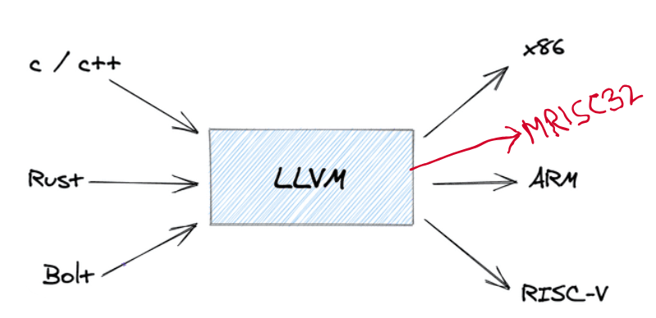
Adding Support for MRISC32 ISA

Slide 6
General flow of LLVM Backend
LLVM IR -> gMIR -> MIR -> MC -> Assembly/Machine Code (ELF, MachO, etc)

Slide 7
GlobalISel
GlobalISel[4] is the framework used in LLVM to convert LLVM IR to target assembly instructions.
Consists of 4 major steps -
IRTranslator -
Converts LLVM IR to Generic Machine IR (gMIR).
Legalizer -
Ensures that every Generic Machine Instruction is legal for the target assembly.
If the target doesn’t support a wide 64-bit add, it might be legalized into two 32-bit operations.
RegBank Select -
Decides whether a value should use GPR, FPR, Vector Register Bank, etc., based on its type and usage.
Instruction Select
Selects instruction available in target architecture.
Uses pattern matching to match gMIR with target specific MIR.

Slide 8
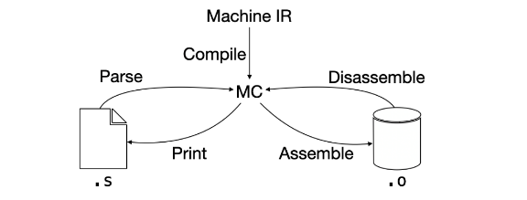
Assembly Printing

Slide 9
For printing assembly code, implementation of mainly two classes are required -
MRISC32AsmPrinter.cpp
MRISC32InstPrinter.cpp

Slide 10
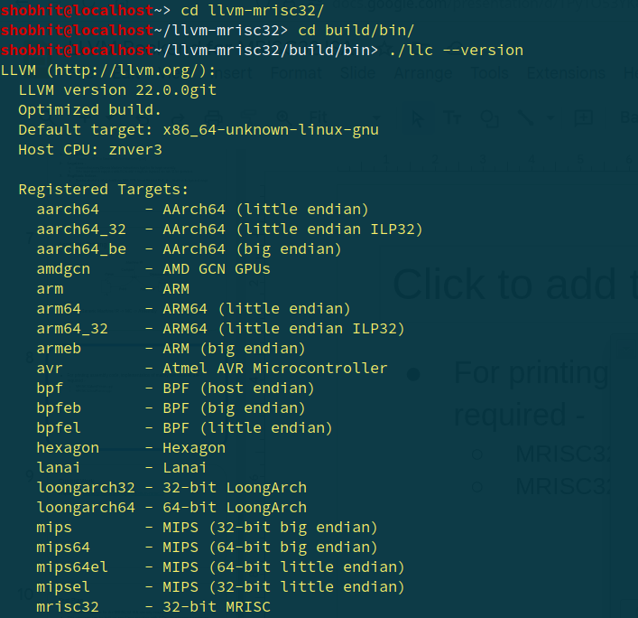
Current status

Slide 11
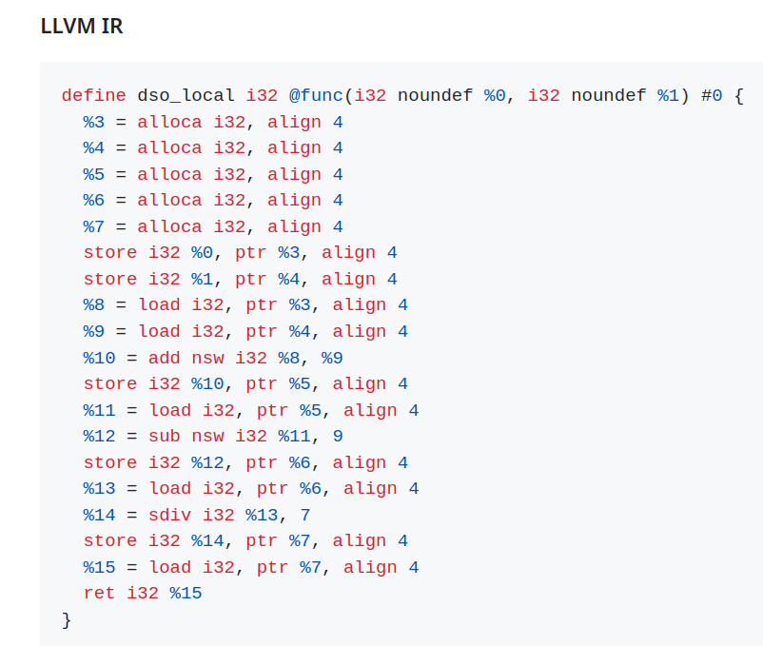
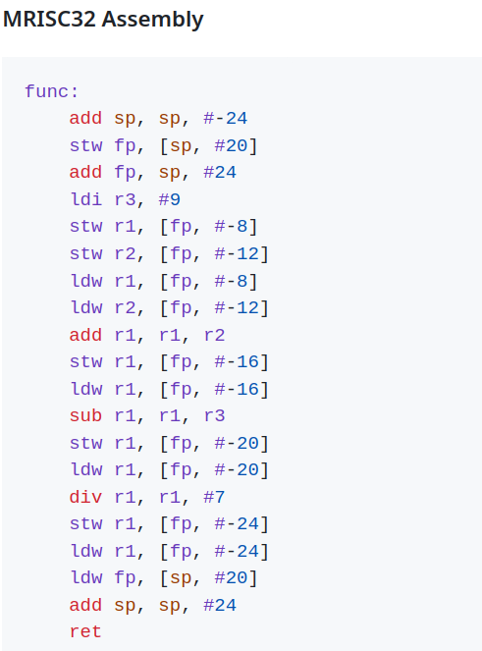
Generation of MRISC32 assembly from LLVM IR

Slide 12
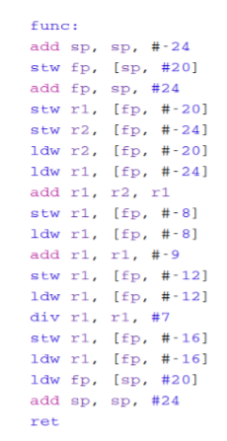
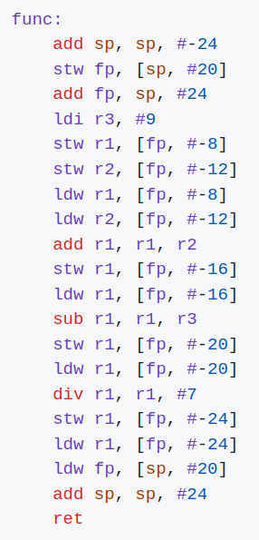
Comparison of code generate by GCC vs LLVM
GCC LLVM

Slide 13
Work to convert LLVM IR to Machine IR is completed.
Work to support generating call lowering is done.
Work to generate function prologue and epilogue is complete.
Work to map variables to actual registers in processor is done.
Work to convert Machine IR to MC layer is complete.
Work to print assembly is complete.
Work to generate ELF binary is complete.
Basic instructions like ADD, SUB, MUL, DIV, LDW, STW, etc are supported.

Slide 14
Current status
Project link - https://github.com/dragon540/llvm-mrisc32

Slide 15
References
Some features of the MRISC32 ISA
MRISC32 Instruction Set Manual
https://llvm.org/
https://llvm.org/docs/GlobalISel/index.html
https://gitlab.com/mrisc32/mrisc32-simulator
https://en.wikipedia.org/wiki/Fuzzing
https://github.com/csmith-project/csmith
Finding Missed Code Size Optimizations in Compilers using LLMs (Davide Italiano, Chris Cummins, 2024)

